Slide 1
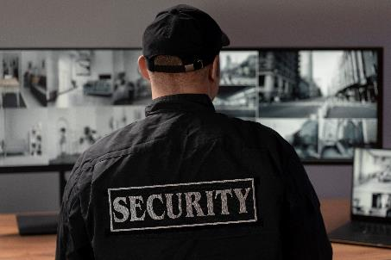

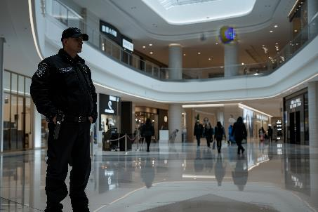
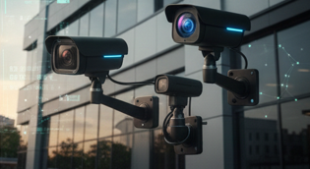
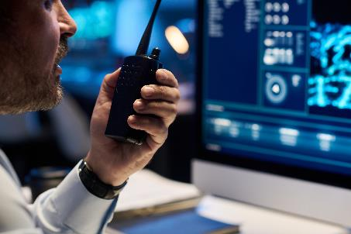
Security Enhancements for Today’s Workplace
Protecting People, Property, and Operations
Facilities Managers Association

Slide 2
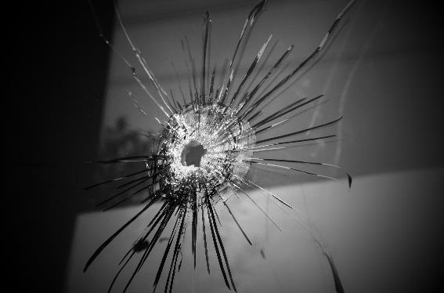

Why Workplace Security Has Changed
Workplace violence is no longer rare or isolated
Commercial and office environments are frequent targets
Most incidents are over before law enforcement arrives
Facilities design and planning directly impact outcomes

Slide 3
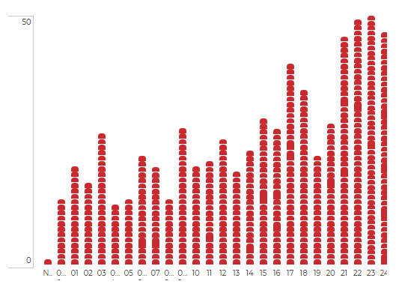
Workplace Shooting Data 2000 to 2024*
Last 25 years:
  613 incidents
  877 deaths
Last 4 years, rapid increase:
  180 incidents
  29.4% of the 2000-2024 total
  223 deaths
  25.4% of the 2000-2024 total
By comparison, US Schools, 2000-2024
  372 incidents
  60.1% of amount of workplace shootings
*The Violence Project Database, https://www.theviolenceproject.org, Hamline University, DOJ sponsored

Slide 4
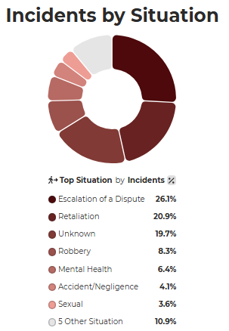
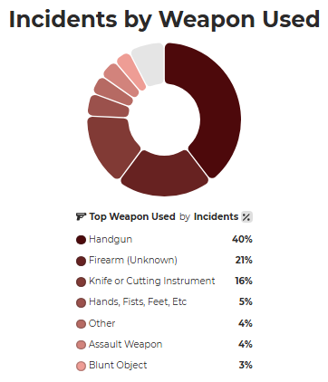
Workplace Shootings*
Predominantly:
Escalations over disputes
Retaliation against a perceived wrongdoing
Using handguns
*The Violence Project Database, https://www.theviolenceproject.org, Hamline University, DOJ sponsored

Slide 5
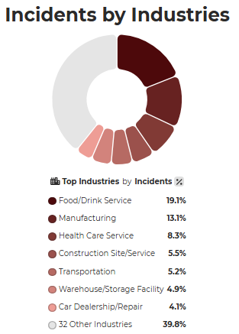
Where Workplace Shootings Occur
Restaurants and bars
Manufacturing facilities
Healthcare
Construction
Transportations
Warehouses
40% spread across a long list of other facility types

Slide 6
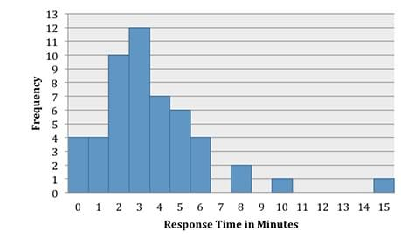
Why This Matters to Facilities Managers
Commercial and business environments remain high-risk
Open access and multiple entry points increase exposure
Seconds of delay can save lives
  FBI study of 51 active shooter attacks*
  Median response time was three minutes
Facilities managers influence both prevention and response
*https://leb.fbi.gov/

Slide 7
Liability for Inaction
Lawsuits
Loss of revenue
Potential business closure
Building relocation
Physical security should be part of your budgeting process, just like all other capital expenditure, annual, and 5-year planning.
  “Not in the budget” is a poor excuse; it reflects poor planning and callous behavior by senior personnel in organizations

Slide 8
Key Takeaways for Workplace Facilities
No workplace is immune
Preparedness reduces casualties
Training + technology + design must work together
Layered security is the most effective approach

Slide 9
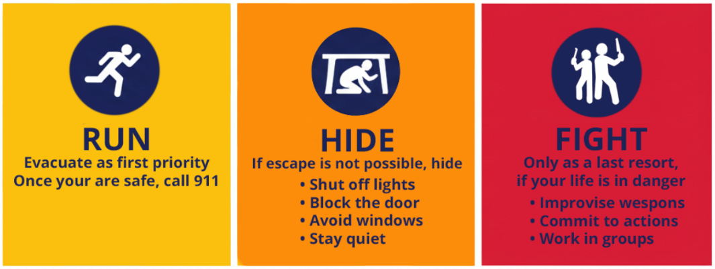
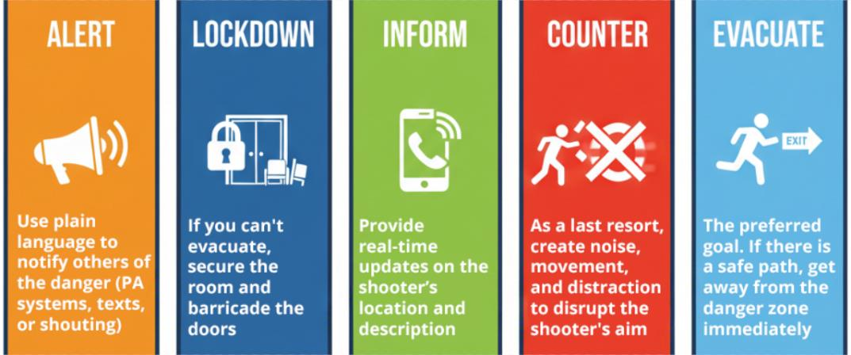
Security Planning & Training
Active shooter response training:
  Run–Hide–Fight
  ALICE
Emergency Action Plans (EAPs)
Tabletop exercises and drills
Clear roles and decision-making protocols

Slide 10
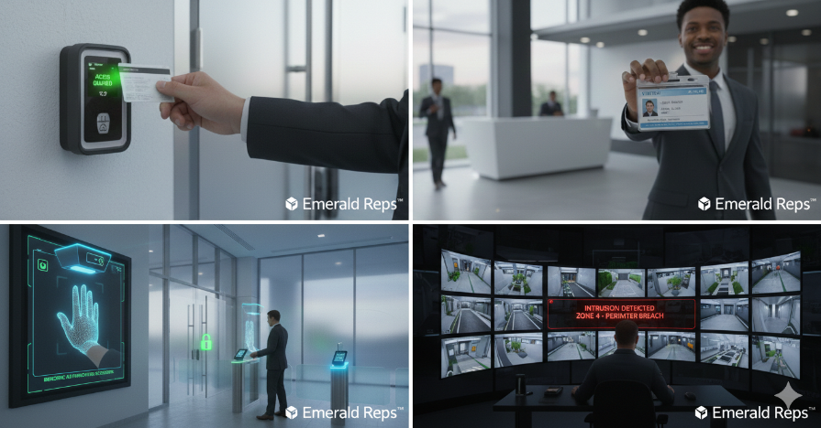
Access Control Systems
Card readers, fobs, and mobile credentials
Visitor management and badging
Zoned access for sensitive areas
Lockdown capability integrated with alerts

Slide 11
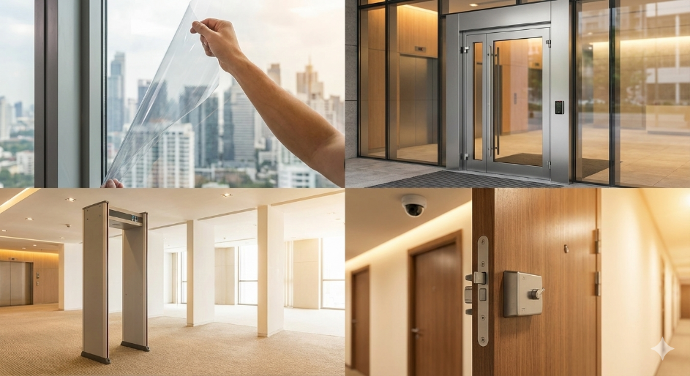
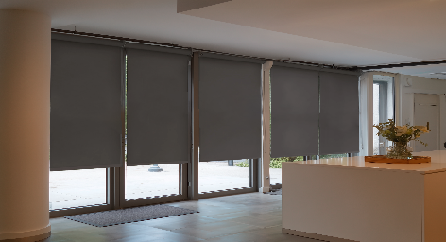
Facility Hardening
Bullet-resistant doors and glazing at key points
Security window film to delay forced entry
Bullet and blast resistant window shades
Protection without altering workplace aesthetics

Slide 12
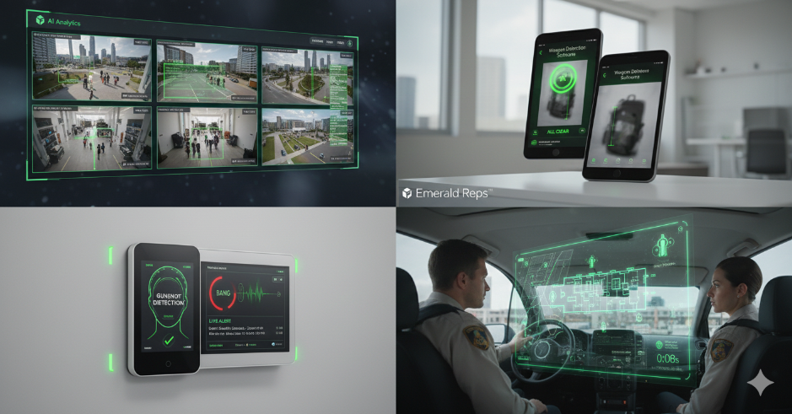
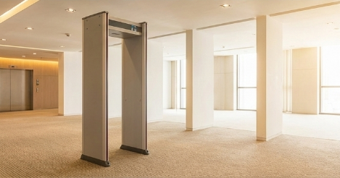
Detection & Monitoring Technologies
Video surveillance with analytics
Weapon detection software
Gunshot detection systems
Faster situational awareness for responders

Slide 13
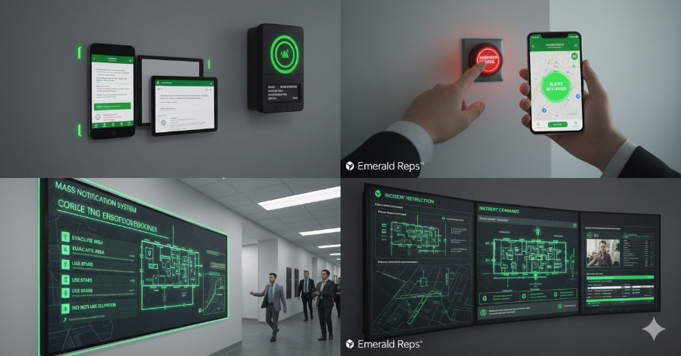

Alert & Communication Systems
Mass notification via text, email, and PA
Panic buttons and mobile safety apps
Clear instructions during emergencies
System integration for rapid response

Slide 14
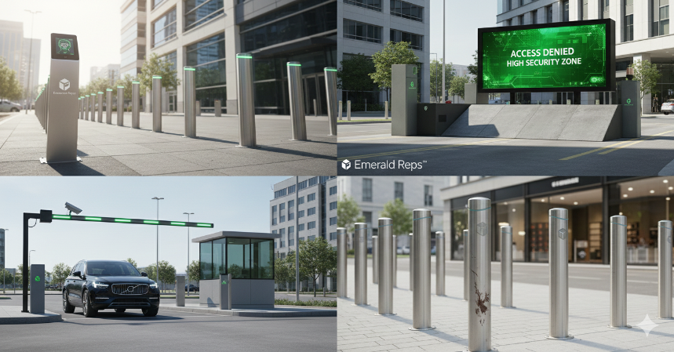
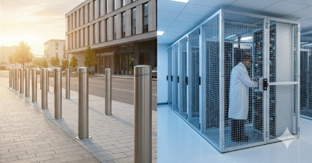
Perimeter & Vehicle Threat Protection
Bollards protecting entrances and pedestrian zones
Crash-rated barriers
Controlled vehicle access points
Protection against intentional or accidental impacts

Slide 15

Continuous Improvement
Budgets rarely allow for a perfect solution immediately:
Make improvements every year
Regular security and risk assessments
Coordination with local law enforcement
System testing and maintenance
Updates as threats and facilities evolve

Slide 16
Layered Security Approach
People
Training
Awareness
Drills
Process
Policies
Plans
Procedures
Technology
Access Control
Cameras
Alerts
Notes:
Effective security relies on layered defenses. People, processes, and technology must work together. If one layer fails, the others provide resilience.

Slide 17
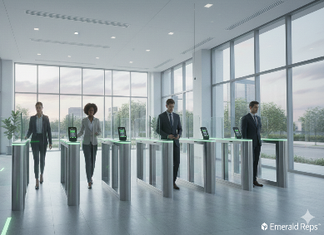
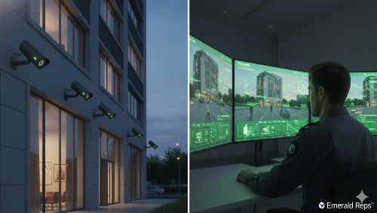

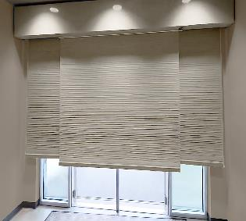
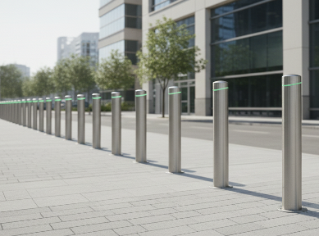
Workplace Facility Security Elements
Access Control
Cameras
Hardened Entry
Bollards
Notes:
This simplified diagram represents how multiple physical and electronic security measures work together within a facility to deter, delay, detect, and respond to threats.

Slide 18
Low-Cost / High-Impact Security Improvements
Active shooter & situational awareness training
Security policy updates (hours, zoning, visitor management)
Security window film vs. glass replacement
Lighting improvements & clear sightlines
Door hardware upgrades (locks, closers, strike plates)
Camera repositioning before adding new cameras
Clear emergency signage and wayfinding
Notes:
Facilities managers often control these improvements directly. They are budget-friendly, quick to deploy, and significantly improve deterrence and response when layered.

Slide 19

Final Thought
Security is not about fear — it is about readiness
Prepared workplaces save lives
Facilities managers play a critical role in resilience

Slide 20
Thank You | Contact Information
John Rotty
Principal | Regional Director
Office Planning Group | Emerald Communications
jrotty@opgtnva.com
john@emeraldreps.com
423-773-8423
www.opgtnva.com
www.emeraldreps.com
Notes:
Thank the audience, invite questions, and offer follow-up discussions or facility risk assessments.

